Slide 1


Information for charities operating overseas
Presented by:
Ian Parry - ACNC Compliance
Emily Moreton - ACFID
Stewart McMillan - ACNC Education
17 September 2024
acnc.gov.au/webinars

Slide 2
The ACNC acknowledges the Traditional Custodians of country throughout Australia and their connections to land, sea and community.
We pay our respects to them and their cultures and elders, past and present.
Notes:
We are presenting our webinar today from the lands of the Wurundjeri people and I wish to acknowledge them as Traditional Owners.
I also acknowledge the Traditional Custodians of the various lands on which you all are joining us from today.
I would also like to pay my respects to their Elders, past and present, and Aboriginal Elders of other communities who may be here today.

Slide 3


Agenda
  What are the External Conduct Standards, and who needs to comply
  How to meet the standards
  The ACFID Code of Conduct
  Tips for operating overseas
  Questions

Slide 4

ACNC External Conduct Standards
Notes:
Your org might need to update gov doc, other info, etc. to meet registration requirements.
Please review and update before you start your application.

Slide 5
The ACNC External Conduct Standards
  Govern how a registered charity must manage its activities and resources outside Australia
  Require charities to take reasonable steps to ensure appropriate standards of behaviour, governance and oversight when undertaking activities or providing funding overseas

Slide 6
Who needs to comply with the External Conduct Standards (ECS)?
  Charities that operate outside Australia, even if its overseas activities are just a minor part of its work
  Basic Religious Charities, if they operate outside Australia, even though they don't have to comply with the ACNC Governance Standards

Slide 7
Operating overseas
Operating overseas includes:
  overseas programs or projects (small or large)
  sending staff, volunteers, or beneficiaries overseas
  working with third parties overseas
  sending money (even small amounts) overseas.

Slide 8
External Conduct Standard 1: Activities and control of resources
  Take reasonable steps to ensure overseas activities are in line with charitable purpose and not-for-profit (NFP) status
  Maintain reasonable internal control procedures so resources are used appropriately
  Ensure resources provided to third parties are used in line with purpose and NFP status, and there are controls in place
Notes:
It also requires charities comply with Australian laws in the following areas while operating overseas:
-money laundering
-financing of terrorism
-sexual offences against children
-slavery and slavery-like conditions
-trafficking in individuals and debt bondage
-people smuggling
-international sanctions
-taxation, and
-bribery.
A charity must maintain reasonable internal control procedures to ensure compliance with these laws.

Slide 9
How to meet External Conduct Standard 1
Some ways to meet this standard include:
  having clear policies for approvals, and recording decisions
  secure services for transferring funds
  conduct due diligence before working with third parties
  monitor overseas projects.
acnc.gov.au/ECS1

Slide 10
External Conduct Standard 2: Annual review of overseas activities and record-keeping
  Requires a charity to obtain and keep records of its operations outside Australia
  Records must include information necessary to prepare a summary of overseas charity activities and expenditure on a country-by-country basis
  Keep records for each financial year when operating, giving funds, or working with third parties overseas

Slide 11
How to meet External Conduct Standard 2
Some ways to meet this standard include:
  keeping complete and accurate records for 7 years
  recording details of all activities overseas, including how the activities further the charity’s purpose
  recording details of all expenditure overseas
  keeping a list of all third parties.
acnc.gov.au/ECS2

Slide 12
External Conduct Standard 3: Anti-fraud and anti-corruption
Requires a charity to take reasonable steps to:
  minimise any risk of corruption, fraud, bribery or other financial impropriety by its Responsible People, employees, volunteers and third parties outside Australia
  identify and document any perceived or actual material conflicts of interest for its employees, volunteers, third parties and Responsible People outside Australia

Slide 13
How to meet External Conduct Standard 3
Some ways to meet this standard include:
  having clear policies for proper and ethical financial management, and ensuring everyone working with the charity knows them
  supervising staff involved in fundraising, managing money or financial reporting
  having a way for people to report suspected wrongdoing without fear.
acnc.gov.au/ECS3

Slide 14
External Conduct Standard 4: Protection of vulnerable individuals
  Take reasonable steps to ensure the safety of vulnerable individuals overseas (including vulnerable beneficiaries, employees, or third party contractors)
  Vulnerable individuals are defined as people under the age of 18, or those who may be unable to take care of themselves, or unable to protect themselves against harm or exploitation.
Notes:
This could be due - but not limited to - their age, an illness, trauma, disability, or some other form of disadvantage.

Slide 15
How to meet External Conduct Standard 4
Some ways to meet this standard include:
  developing a policy and a code of conduct for protecting vulnerable individuals
  prioritise the safety of vulnerable people when selecting third parties
  ensuring staff and volunteers are suitably qualified in safeguarding vulnerable people and properly supervised when working with them
acnc.gov.au/ECS4

Slide 16



ACFID Code of Conduct
Notes:
Introduction

Slide 17

About ACFID
The Australian Council for International Development (ACFID) is the peak body for Australian non-government organisations involved in international development and humanitarian action.
LEAD
CONVENE
BROKER
OUR SHARED VISION
Australia acting with compassion and fairness for a just, sustainable and equitable world.
SUPPORT
Standard setting through the ACFID Code
Voice to government
Forefront of emerging sector issues
Policy development
Networking and Events
Committees and Communities of Practice
Research
Introductions / relationships
Collaborations
Training
Notes:
ACFID is the peak body for Australian NGOs that are involved in development and humanitarian action.
ACFID helps to lead change and influence policy that relates to Australia’s aid program. We do this through advocacy to government
We also set standards for the Australian NGO sector through the ACFID Code of Conduct which I will speak more about shortly.
As a membership organisation, we also focus on convening our members and brokering relationships, including providing a learning program and opportunities to work collaboratively with other organisations.

Slide 18

ACFID’s Membership
The ACFID membership is comprised of Australian organisations that actively work in the international aid and development sector.
Notes:
ACFID currently has 128 Full members and 21 affiliates – these include large household name NGOs, and smaller single-issue or country specific organisations.
Our members work across all sectors, and over half of our member are small-medium organisations that disburse under $1M to international development projects.

Slide 19
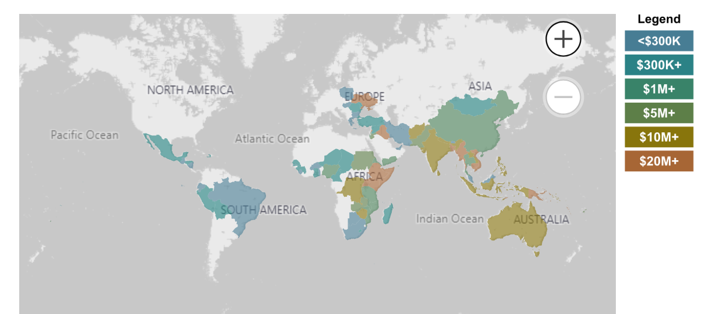

Where our members work
Stats survey
2023
Notes:
All ACFID members work overseas – usually through partner organisations or by delivering programs themselves. You can see in this image, that our membership primarily work in South East Asia, East Africa and the Pacific.
This map comes from an NGO aid map which ACFID hosts on our website. You can search this database to find out information about which ACFID members are working in each country, what sectors they are working in and even the specific projects.

Slide 20
Why organisations join ACFID
Be part of an internationally recognised network
IMPROVED STANDARDS
Transparency and accountability
Increased donor trust
Curated support to develop policies
Guidance towards ANCP
NETWORKING, COLLABORATION AND LEARNING
Communities of Practice
Variety of virtual and F2F events deigned to improve practice in relation to areas of the code
Brokering introductions
Join multi agency and cross sector projects
Individual, tailored advice as required
INFLUENCE AND ADVOCACY
Influence the direction of ACFID and international development through strategic committees
Add your voice to united advocacy efforts on behalf of the membership
Access to politicians and government
STAY UP TO DATE
Receive strategic and operational information for CEOs
Regular sector news and member bulletins
Contribute to our sector data collection to help stay on top of trends and changes in the sector
Notes:
There are many reasons why organisations choose to join ACFID – some of them are listed here. Some organisations are very interested in participating in more advocacy and engagement with Government, while others want to build a network with other NGOs.

Slide 21
Why organisations join ACFID
Be part of an internationally recognised network
IMPROVED STANDARDS
Transparency and accountability
Increased donor trust
Curated support to develop policies
Guidance towards ANCP
NETWORKING, COLLABORATION AND LEARNING
Communities of Practice
Variety of virtual and F2F events deigned to improve practice in relation to areas of the code
Brokering introductions
Join multi agency and cross sector projects
Individual, tailored advice as required
INFLUENCE AND ADVOCACY
Influence the direction of ACFID and international development through strategic committees
Add your voice to united advocacy efforts on behalf of the membership
Access to politicians and government
STAY UP TO DATE
Receive strategic and operational information for CEOs
Regular sector news and member bulletins
Contribute to our sector data collection to help stay on top of trends and changes in the sector
Notes:
For many organisations, one of the main reasons they join is the ACFID Code of Conduct.
Meeting the standards in the ACFID Code helps them to demonstrate to their supporters and donors that they are meeting good practice standards set by the sector, and improve their accountability and effectiveness.

Slide 22

ACFID Code of Conduct
Integrity. Accountability. Impact
VOLUNTARY and SELF-REGULATORY
OWNED BY ACFID MEMBERS
INDEPENDENT COMPLAINTS HANDLING MECHANISM
ALL FULL MEMBERS OF ACFID MUST DEMONSTRATE COMPLIANCE WITH THE CODE
Notes:
The ACFID Code has been around for more than 25 years.
It is a voluntary and self-regulatory standard. This means it is developed by the sector, for the sector, and primary responsibility for compliance with the Code rests with the ACFID member. Organisations can choose to join ACFID and therefore choose to meet the standards in the Code.
The Code is owned by ACFID members, not ACFID, and changes to the Code can only be made by agreement from the membership. Therefore the Code reflects the shared understanding of what constitutes accountable and effective practice.
To hold ACFID members to account, the Code is supported by an independent complaints handling mechanism. Anyone can make a complaint if they believe an ACFID member has breached the Code, and you can find more information about this on our website.
Meeting the standards in the Code is a core part of ACFID membership. Organisations must demonstrate and commit to meeting the Code as part of their membership application, and then through annual reporting to ACFID. While all members meet the Code requirements, the way they do this is commensurate with the size and activities of their organisation.

Slide 23

Notes:
https://www.youtube.com/watch?v=6eyGFIpr3kI

Slide 24
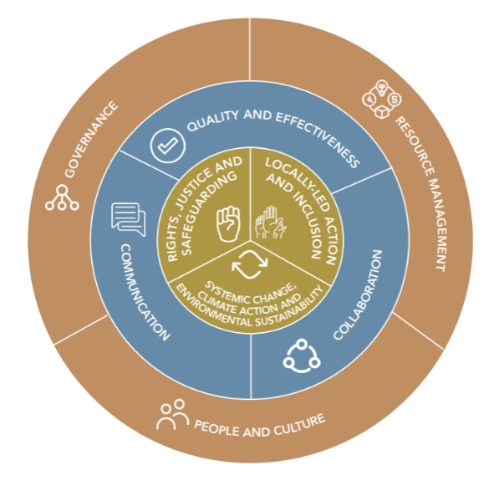
What does the Code cover?
24
Notes:
The Code outlines standards for all aspects of an organisation’s work.
[CLICK} This includes the systems that help them to function as an organisation, such as their financial management, governance processes and how they manage volunteers and staff.
This section of the Code includes requirements that align with the ACNC Governance Standards and External Conduct Standards, and address issues like fraud and corruption, along with additional issues like fundraising and HR.

Slide 25
What does the Code cover?
25
Notes:
The Code sets standards for how ACFID members work in partnership with others, how they plan, monitor and evaluate their work and communicate this to others, including the public.

Slide 26
What does the Code cover?
26
Notes:
And finally the Code sets standards around the approaches that underpin the work that ACFID members do overseas.
For example, promoting human rights, investing in local leadership, and ensuring their work is contributing towards systemic and sustainable change.
This part of the Code also aligns with the External Conduct Standard 4, ensuring children and vulnerable people are protected.

Slide 27
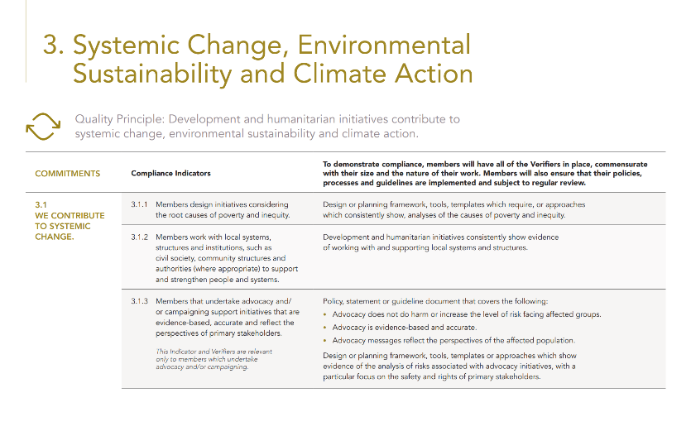
Quality Principle
Commitments
Compliance Indicators
Verifiers
Notes:
The Code outlines the high level commitments for ACFID members, but also sets out the types of evidence required to demonstrate there are meeting those commitments.

Slide 28

What do our members value about the Code?
As a small organisation it holds us accountable to keeping up with changing good practices.
Provides simple but necessary standards to help us be a trusted and good practice Australian NGO.
Ensures accountability and that we always strive to do what we do better.
Helps us practically reflect on the organisation’s impact and work.

Slide 29
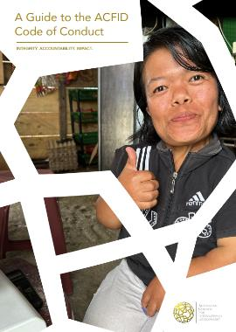



Updating the Code
1997
Code of Conduct first developed
2010
Comprehensive Code Review
2016
Complete restructure and review of the Code
2019
PSEAH components added
2024
New Code launched
Notes:
It is important that the Code remains up to date, and useful for our Members.
The Code is reviewed every 5-6 years, through a thorough consultation process, which includes others outside the membership such as DFAT, ACNC and our partners and networks overseas.
The most recent version of the Code was launched a couple of weeks ago, following an 18 month review process, and we were very pleased to have the ACNC Commissioner, Sue Woodward, launch the revised Code.
Through the consultation process we looked at the emerging issues facing our members and the communities they are working with overseas, and opportunities to better streamline the Code requirements, and align then with others standards.

Slide 30
What’s new?
STRENGTHENING CRITICAL ISSUES
For example, ACFID members will be required to:
Consider risks associated with climate change when designing their activities.
​
Commit to minimising the carbon footprint of their organisation.
Climate change
Racial justice
Locally-led development
Safeguarding
Notes:
Some of the changes that have been made aim to strengthen how our members are responding to critical issues.
For example, ACFID members are now required to think about and respond to risks associated with climate change, and commit to minimising the carbon footprint.

Slide 31
What’s new?
STRENGTHENING CRITICAL ISSUES
For example, ACFID members will be required to:
Provide access to safe training in issues related to diversity and anti-racism for governing body, senior leadership, staff and volunteers.
​
Ensure their human resource policies cover equity, diversity and anti-racism.
Climate change
Racial justice
Locally-led development
Safeguarding
Notes:
Racial justice is another critical issue and ACFID members will be required to provide training in issues related to diversity and anti-racism, and ensure their HR policies cover equity, diversity and anti-racism.
ACFID provides resources and guidance to help members meet these requirements.

Slide 32
What’s new?
STRENGTHENING CRITICAL ISSUES
For example, ACFID members will be required to:
Ensure the voice and decision-making of local actors in all stages of a program, the allocation of resources and the design and evaluation of feedback and complaints mechanisms. ​​
Have regular partnership meetings where open feedback and dialogue is facilitated.​
Climate change
Racial justice
Locally-led development
Safeguarding
Notes:
There is also a big focus in the sector on investing in local decision making and engaging in equitable partnerships. ACFID members will need to demonstrate how they are doing this, as relevant to their operating context.

Slide 33
What’s new?
STRENGTHENING CRITICAL ISSUES
Climate change
Racial justice
Locally-led development
Safeguarding
ACFID members involved in humanitarian response will be required to join the Misconduct Disclosure Scheme.
Notes:
And the Code continues to be strengthened to protect individuals and communities from harm, with humanitarian organisations required to join the international Misconduct Disclosure Scheme. This Scheme aims to prevent the movement of perpetrators of sexual abuse between organisations, particularly in high risk settings. If you are interested in knowing more about the Scheme pleas get in touch.

Slide 34
What’s new?
STRENGTHENING CRITICAL ISSUES
IMPROVE ALIGNMENT WITH OTHER STANDARDS
Climate change
Racial justice
Locally-led development
Safeguarding
Whistleblowing
Accounting Standards
ACNC
DFAT
Notes:
Finally, we also made changes that would ensure the Code remains up to date with other legislative and regulatory requirements.

Slide 35
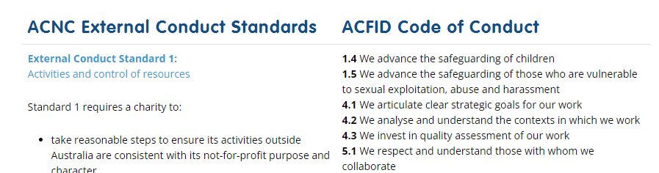
ACFID Code and ACNC ECS
If a charity complies with the ACFID Code of Conduct, it is likely to meet the External Conduct Standards.
However, the ACNC may still require a charity to demonstrate how it meets the External Conduct Standards.
The ACNC and ACFID have worked together to map the revised ACFID Code to the External Conduct Standards.
Notes:
In terms of the ACNC Standards, if a charity complies with the ACFID Code then it is likely to meet the External Conduct Standards.
We have worked together with the ACNC team to map the revised Code and the External Conduct Standards, and the Governance Standards, and this mapping can be found on the ACNC website.

Slide 36

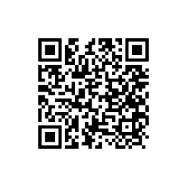



ACFID Resources
Online Good Practice Toolkit – acfid.asn.au/good-practice-toolkit
Curated resources and guidance to help organisations meet the standards in the Code
Policy Guidance
More detailed policy guidance in specific areas:
Child safeguarding
Complaints handling
Prevention of financial wrongdoing
Disability inclusion
E-learning modules – learnwithacfid.com
Notes:
Before I finish, one of the key messages I wanted to leave with you is that there are a lot of resources freely available through ACFID’s website. Our aim through the Code is to help improve the standards and practice across the broader international development sector, including organisations that aren’t ACFID members.
If your organisation is operating overseas, or you’re thinking about doing so, ACFID’s website has an extensive Good Practice Toolkit which outlines the standards in the Code, but also has curated resources and guidance. This includes lots of examples of policies and documents from ACFID members as well as specific policy guidance developed by ACFID, and links to external resources. You can access the Good practice toolkit through the QR code on the screen or the link.
We also have an e-learning platform, Learn with ACFID, and nearly all our courses are freely available to anyone. Our introduction to safeguarding course if translated into 11 languages if you have staff or partners overseas.

Slide 37
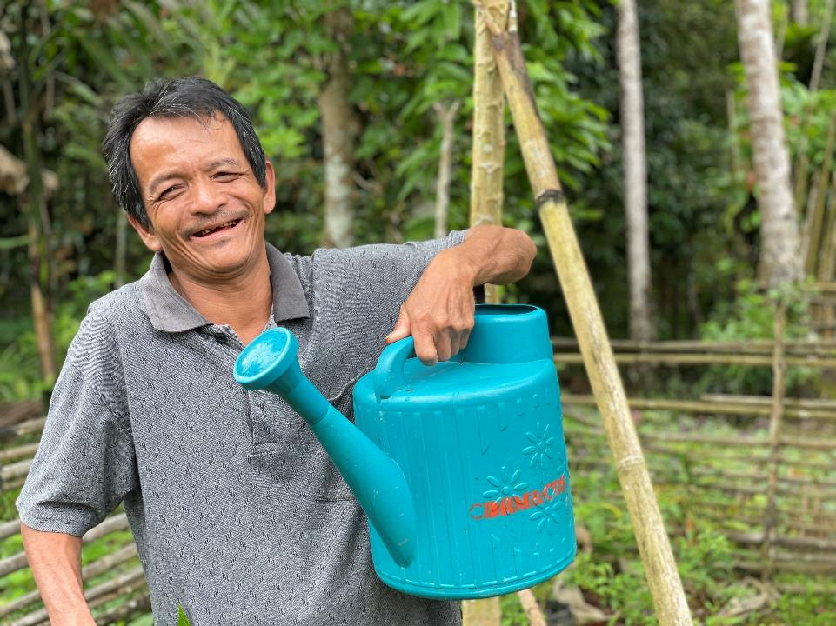


CONTACT US
acfid.asn.au
membership@acfid.asn.au
/ACFID
/acfid
@acfid
14 Napier Close, Deakin, ACT 2600
Photo (pg 1): Ananeth poses with her Unblocked Cash Card. Arlene Bax / Oxfam.
Photo (pg 22): Adeili poses with his watering can. Australian Lutheran World Service
Notes:
That brings me to the end of this overview of the Code and ACFID.
If you have any questions please get in touch.

Slide 38

Tips for operating overseas
Notes:
Your org might need to update gov doc, other info, etc. to meet registration requirements.
Please review and update before you start your application.

Slide 39
Advice for small charities operating overseas
  Larger charities with complex overseas operations will likely need to do more to comply than a small charity with straightforward operations overseas.
  Charities working directly with overseas partner organisations must have oversight of their activities, measures to protect vulnerable people, account for funds, and record outcomes.

Slide 40
How to manage operating overseas in a crisis
When providing humanitarian assistance (including through third parties) charities must ensure funds are protected from misuse and are used for the charitable purpose
The people the charity deals with must not be designated under Australian sanctions law
Good planning, policies and procedures will help manage the consequences of something going wrong

Slide 41
Sending money overseas
  Make sure the charity's funds and projects are approved by more than one person
  Use secure, monitored services when transferring funds
  Ask recipients to confirm funds are received
  Take steps to prevent corruption and misallocation of funds
Notes:
Charities that send funds must comply with ECS, even if they don't otherwise operate overseas

Slide 42
Working with third parities
  If charities work with third parties, they still need to meet the External Conduct Standards
  Conduct due diligence to ensure the overseas organisation has appropriate processes
  The standards still apply to work that is outsourced – it is the charity’s responsibility to ensure all work is conducted in line with them

Slide 43

Resources
Notes:
Your org might need to update gov doc, other info, etc. to meet registration requirements.
Please review and update before you start your application.

Slide 44

ACNC resources
  Learn more about the External Conduct Standards: acnc.gov.au/ECS
  Test your knowledge: acnc.gov.au/ECS-quiz
  How the External Conduct Standards map to the ACFID Code of Conduct: acnc.gov.au/ACFID-ECS
Notes:
Key resources - who can apply, apply online in portal, more info about self-assessing.
Links in this presentation for other relevant topics

Slide 45

ACFID resources
ACFID Code of Conduct:
acfid.asn.au/code-of-conduct
  Online Good Practice Toolkit: acfid.asn.au/good-practice-toolkit
  E-learning modules: learnwithacfid.com
Notes:
Any questions about tax, non-charitable NFPs, self-assessing - please contact ATO.

Slide 46

Questions
Notes:
Your org might need to update gov doc, other info, etc. to meet registration requirements.
Please review and update before you start your application.

Slide 47




Stay in touch
  Monthly newsletter - acnc.gov.au/#subscribe
  Web guidance - acnc.gov.au
  Webinars - acnc.gov.au/webinars
  Podcasts - acnc.gov.au/charitychat
  Contact us - acnc.gov.au/contact-us
facebook.com/acnc.gov.au​
@acnc_gov_au
youtube.com/ACNCvideos
linkedin.com/company/australian-charities-and-not-for-profits-commission​

Slide 48
Thank you
View this or previous webinars, and register for future sessions, at acnc.gov.au/webinars​
​
Questions, comments, feedback:​
education@acnc.gov.au

